Slide 1

FINANCIAL & BUSINESS SERVICES
Training for Travelers
fbs.admin.utah.edu

Slide 2
FINANCIAL & BUSINESS SERVICES
UTravel is the new paperless and mobile system for the University of Utah. This system will increase efficiency, decrease paper waste, and allow travelers to make travel reservations.
fbs.admin.utah.edu

Slide 3
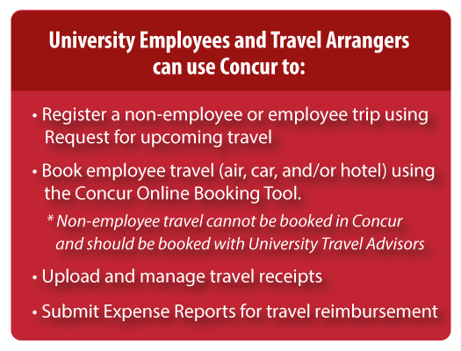
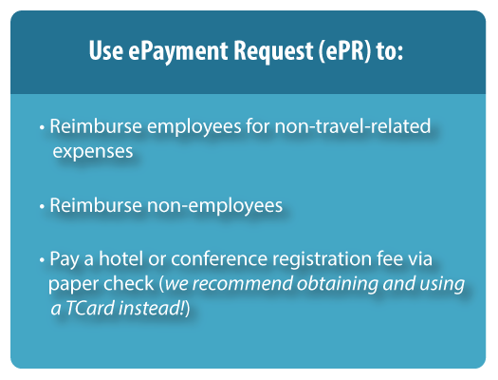
FINANCIAL & BUSINESS SERVICES
fbs.admin.utah.edu

Slide 4
FINANCIAL & BUSINESS SERVICES
Login
Go to http://utravel.utah.edu – this will route you to your Campus Information System (CIS) login.
Your User Name is your UNID @ utah.edu (ex: u1234567@utah.edu) and your Password is the same as your CIS password.
Changes to your password need to be done through CIS, because they are linked.
fbs.admin.utah.edu

Slide 5
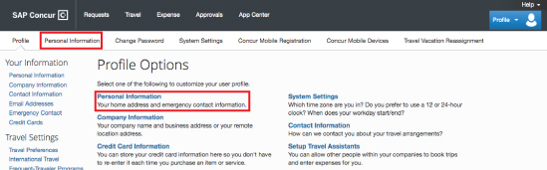
FINANCIAL & BUSINESS SERVICES
Profile
Your UTravel Profile stores your personal information used for booking travel and creating expense reports. Before you begin, it is important to update your personal information to ensure accuracy when booking travel and activating Concur features.
Once you have logged in and are on the home page, click Profile in the top right corner, and then Profile Settings.
From the Profile Settings page, click Personal Information.
fbs.admin.utah.edu

Slide 6
FINANCIAL & BUSINESS SERVICES
Name and Addresses
Make sure your name matches your government issued ID or passport. The name will transfer to travel bookings made in the UTravel Concur System or the travel agency.
fbs.admin.utah.edu

Slide 7

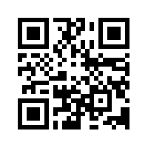
FINANCIAL & BUSINESS SERVICES
Mobile Device
Registering a mobile device is required to take advantage of Concur’s mobile technology and upload electronic receipts.
fbs.admin.utah.edu

Slide 8
FINANCIAL & BUSINESS SERVICES
SAP Concur Mobile Registration
To use the Concur Mobile app, open the app on your phone and log in with your Concur Username (this is your UNID@utah.edu address) and the PIN you will create.
fbs.admin.utah.edu
Notes:
JAKE – We think more pictures and less words will be better here. See Traveler Guide.

Slide 9
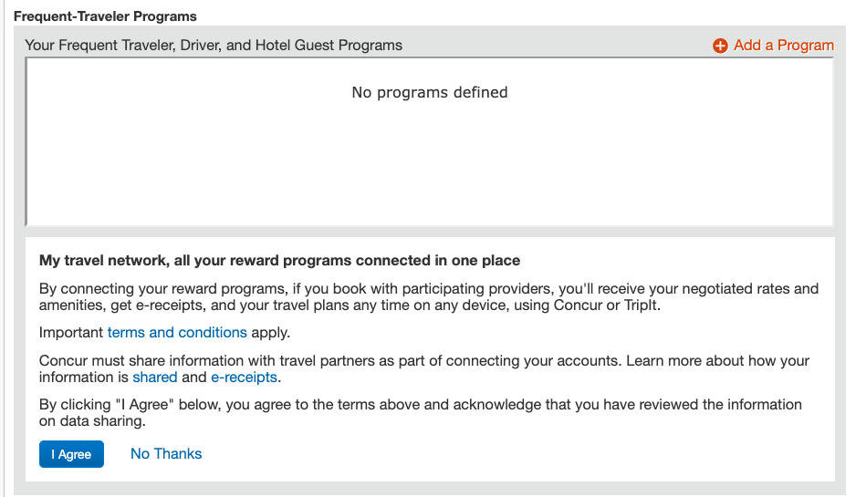
Add Frequent Traveler Programs & Enroll in My Travel Network

Slide 10
Update Request/Expense Delegates
Assign people to Prepare, Submit, or Approve on your behalf inside Profile

Slide 11
FINANCIAL & BUSINESS SERVICES
Group/Arranger TCard
Credit Card
Group/Arranger TCard (Main Contact: Marisa) can be used for Employee, Guest or Group Tripsto pay for travel expenses:
  Conference Registration Fees for Employee/Guest
  Lodging/Hotel Pre-Payments for Employee/Guest
A personal credit card is required if you chose to reserve a hotel through UTravel. The credit card will not be charged and is only used to reserve/guarantee the room, and is protected and masked by Concur.
fbs.admin.utah.edu

Slide 12
FINANCIAL & BUSINESS SERVICES
Submit New Travel Request
Submit New Travel Request: one day prior to leaving for all Domestic Travel, and three weeks prior for all International Travel.
  http://mech.utah.edu
  Resources
  Office Forms
  New Travel Request
  Email New Travel Request:
    Travel Arranger: marisa.deleon@utah.edu
  Please make sure that your Travel Arranger can book travel, prepare, submit, and approve on your behalf.
  Once full approved you can use the booking link to reserve air, car and/or hotel?
fbs.admin.utah.edu

Slide 13
FINANCIAL & BUSINESS SERVICES
Submit Expense Report
2. Submit Expense Report: within 60 days of completion of trip.
  http://mech.utah.edu
  Resources
  Office Forms
  Travel Reimbursement Request
  Email Travel Reimbursement Request:
    Travel Arranger: marisa.deleon@utah.edu
  Please make sure that you have uploaded all receipts through Concur online or mobile system so Travel Arranger can expense all items to correct detail, type and source on your behalf.
  DO NOT Submit Request through Concur. Travel Arranger will submit this for you after reviewing your Travel Reimbursement Request and receipts to ensure that all items submitted to correct expense type, source and activities and chartfields.
fbs.admin.utah.edu

Slide 14
FINANCIAL & BUSINESS SERVICES
7 Things Travelers need to do Themselves
Create Concur Personal Information Profile (Slide 5)
Download and sign in on Mobile Device (Slide 7)
Verify your UNID@utah.edu (ex: u1234567@utah.edu) email address in profile (Slide 8)
Enroll in My Travel Network for reward programs (Optional) (Slide 9)
Update Request/Expense Delegates (Slide 10)
Submit New Travel Request (Slide 12)
Submit Expense Report (Slide 13)
fbs.admin.utah.edu

